Slide 1
The Economic Impact of COVID-19 and Prospects for a Post-Pandemic Economic Recovery in Africa
Prof. Njuguna Ndung’u | Feb 28, 2022

Slide 2
AERC
African Economic Research Consortium Capacity building Framework
Training
Collaborative Masters Programme (CMAP)
Collaborative Masters in Applied & Agri. Economics (CMAAE)
Collaborative PhD Programme (CPP)
The AERC
Approach to Capacity Building and Knowledge Generation in SSA
RESEARCH
Thematic Research
Collaborative Research
Special Workshops
Policy Outreach
Senior Policy Seminars
National Policy Workshops
Institutions & Network

Slide 3
Outline
Initial conditions mattered in the fight against the COVID-19 pandemic.
Lockdowns were severe initially in many countries in Africa.
The social and economic impact of the COVID-19 pandemic in Africa was significant.
Lockdowns supplemented by social protection and application of digital technology lowered infections and fatality rates.
Policy priorities for post-COVID-19 recovery.

Slide 4
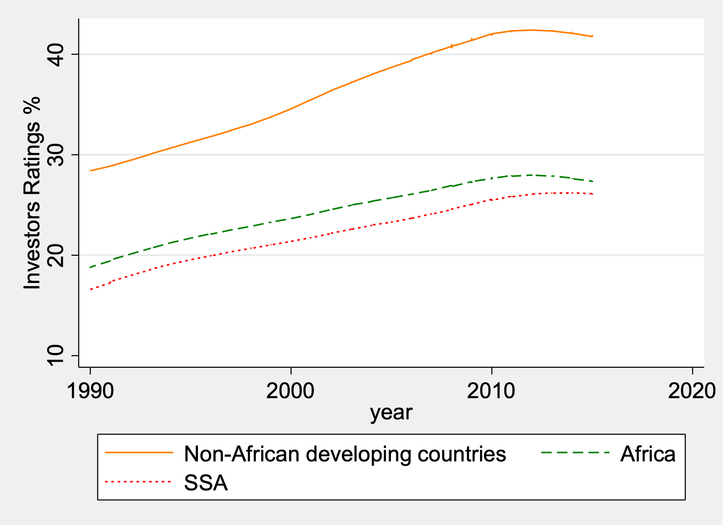
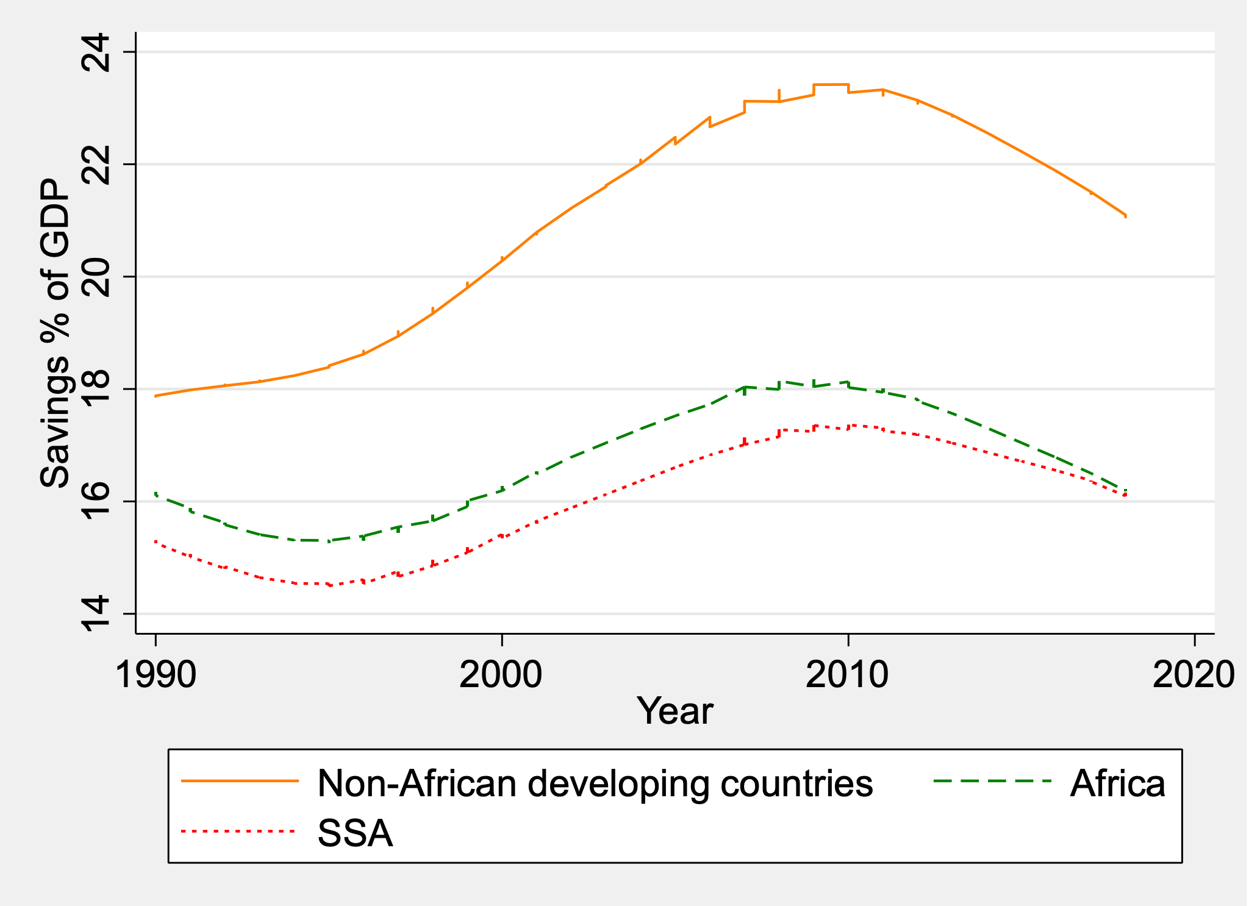
Initial conditions in Africa were delicate prior to the pandemic
Prior to the pandemic, growth had been fragile due to weak economic fundamentals and lack of structural change.
The pace of economic reform had been slow, and, in some cases, there were policy reversals.
The capacity of the state to withstand shocks and health systems to stem a pandemic was low.
Investors’ Ratings of Developing Economies
Savings as a share of GDP

Slide 5
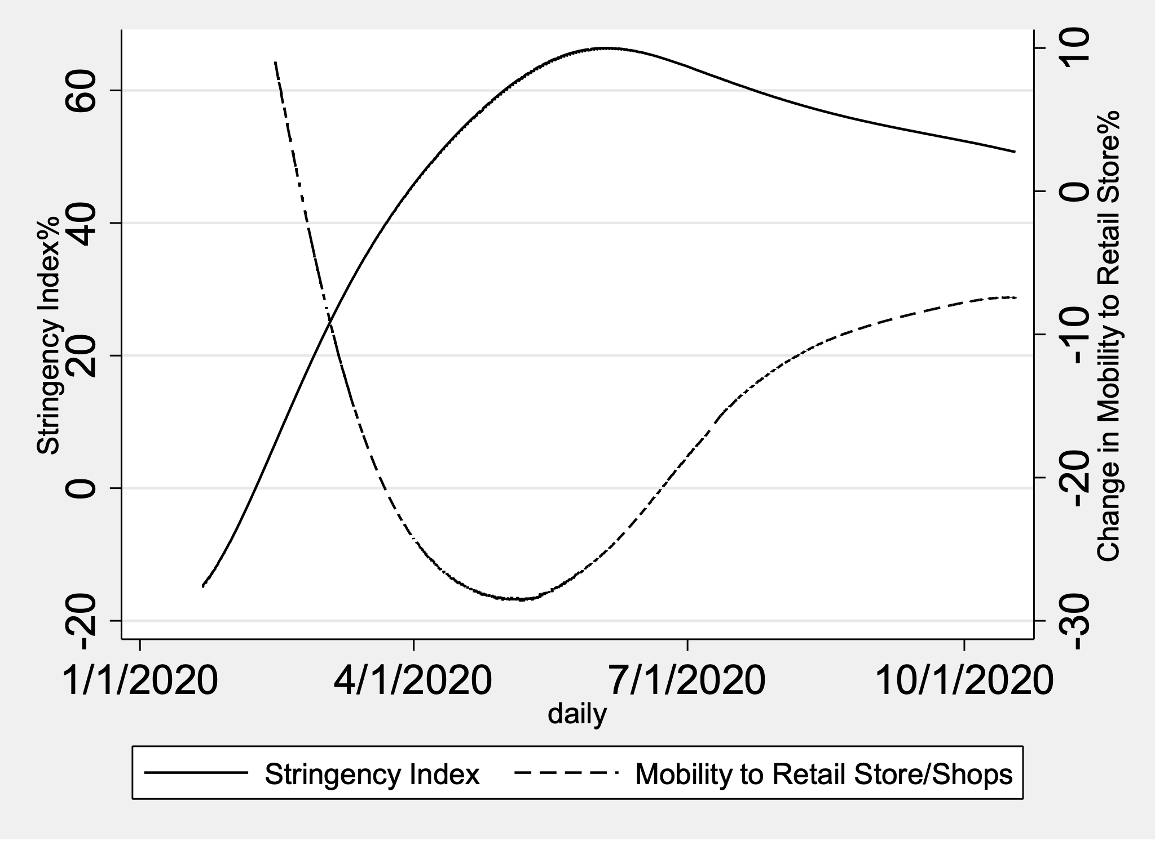
The policy responses to contain the COVID-19 pandemic in Africa were severe initially
Stringency index and actual mobility change in Africa
Significant lockdowns were
observed early March 2020 to July 2020.
But variations across countries on the degree of lockdown was high.
For example, during March 1/2020 to October 18/2020 average stringency index was 61% with standard deviation of 23% or average reduction of mobility was -18% with standard deviation of 20%.

Slide 6
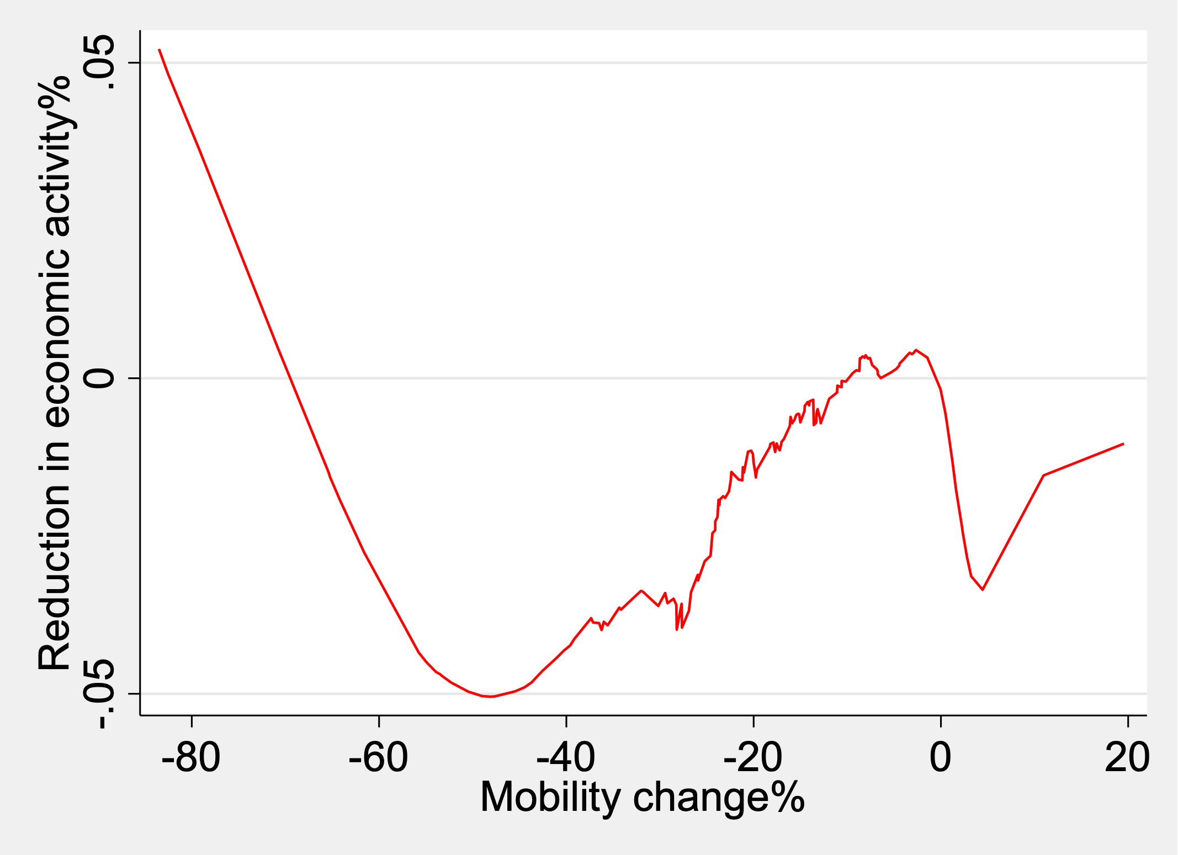
Economic Impact of the Policy Responses/1
Lockdowns led to significant disruptions in economic activities.
A 1% reduction in mobility led to 0.1% reduction in real GDP growth (graph based on monthly night light data and Google data on changes in monthly of people).
At the height of the pandemic, real GDP declined by about 5% in Africa.
Association between monthly night light data and lockdowns

Slide 7
Economic Impact of the Policy Responses/2
Nationally representative household surveys conducted at the height of the pandemic in 10 African countries showed that a large percentage of households lost jobs, incomes and a significant proportion reduced food consumption.
The bulk of households received cash transfers from families and close friends.
Country | Job loss (%) | Income loss | Food consumption reduced | Transfer received
Burkina Faso | 20.78 | 45.12 | 46.08 | 45.92
Chad | 33.05 | 58,65 | 43.67 | 49.43
Djibouti | 34.76 | 17.18 | 43.11 | 14.94
Ethiopia | 20 | 50 | 23 | 13
Kenya | 12 | NA | 40 | 9
Malawi | 25.43 | 67.43 | 49.47 | 67.12
Mali | 58.54 | 51.14 | 49.25 | 38.39
Nigeria | 65.1 | 72.9 | 56.87 | 14.22
South Africa | 37.1 | 41 | 26 | 16.00⁺
Uganda | 54.16 | 52.87 | 25.79 | 22.5

Slide 8
Economic Impact of the Policy Responses/3
The fiscal stance of many African countries was battered.
External debt as a share of GDP jumped from around 60% to 72%.
Macroeconomy instability worsened in many countries.
Fiscal balance in Africa

Slide 9
Effectiveness of lockdowns and accompanying policies in containing the pandemic
A 1% decrease in daily mobility of people to their workplaces or stringency measures led to a reduction of daily infection rates between 0.15%-0.33%, which is significant.
Accompanying measures such as strong health systems, community awareness of the pandemic, etc., further decreased daily infection rates by about 5% and fatality rates by about 3%.
To support compliance, many governments in Africa facilitated income protections and food assistance programs mitigating social unrest, riots and violence.
Digital revolution and digitalization found space and application where targeted government assistance, interpersonal cash transfers and food deliveries were facilitated despite lockdowns.

Slide 10
Policy priorities for post-COVID-19 recovery/1
Protect human capital
The pandemic undermined education, especially of children and the young whose long-term impact is yet to be understood. Evidence suggests that school closures disproportionately impacted children with little or no access to virtual learning facilities.
Reforming the health system, including financing health care is crucial. A move towards universal health insurance cannot be overemphasized.
Policies to care for the elderly, and other vulnerable groups require renewed commitments as they have been impacted by the pandemic.
Develop and protect markets
The pandemic exposed weaknesses in the supply chains, fragmented markets and labor markets. Delayed reforms in many countries to improve the investment climate and doing business cost African economies dearly.

Slide 11
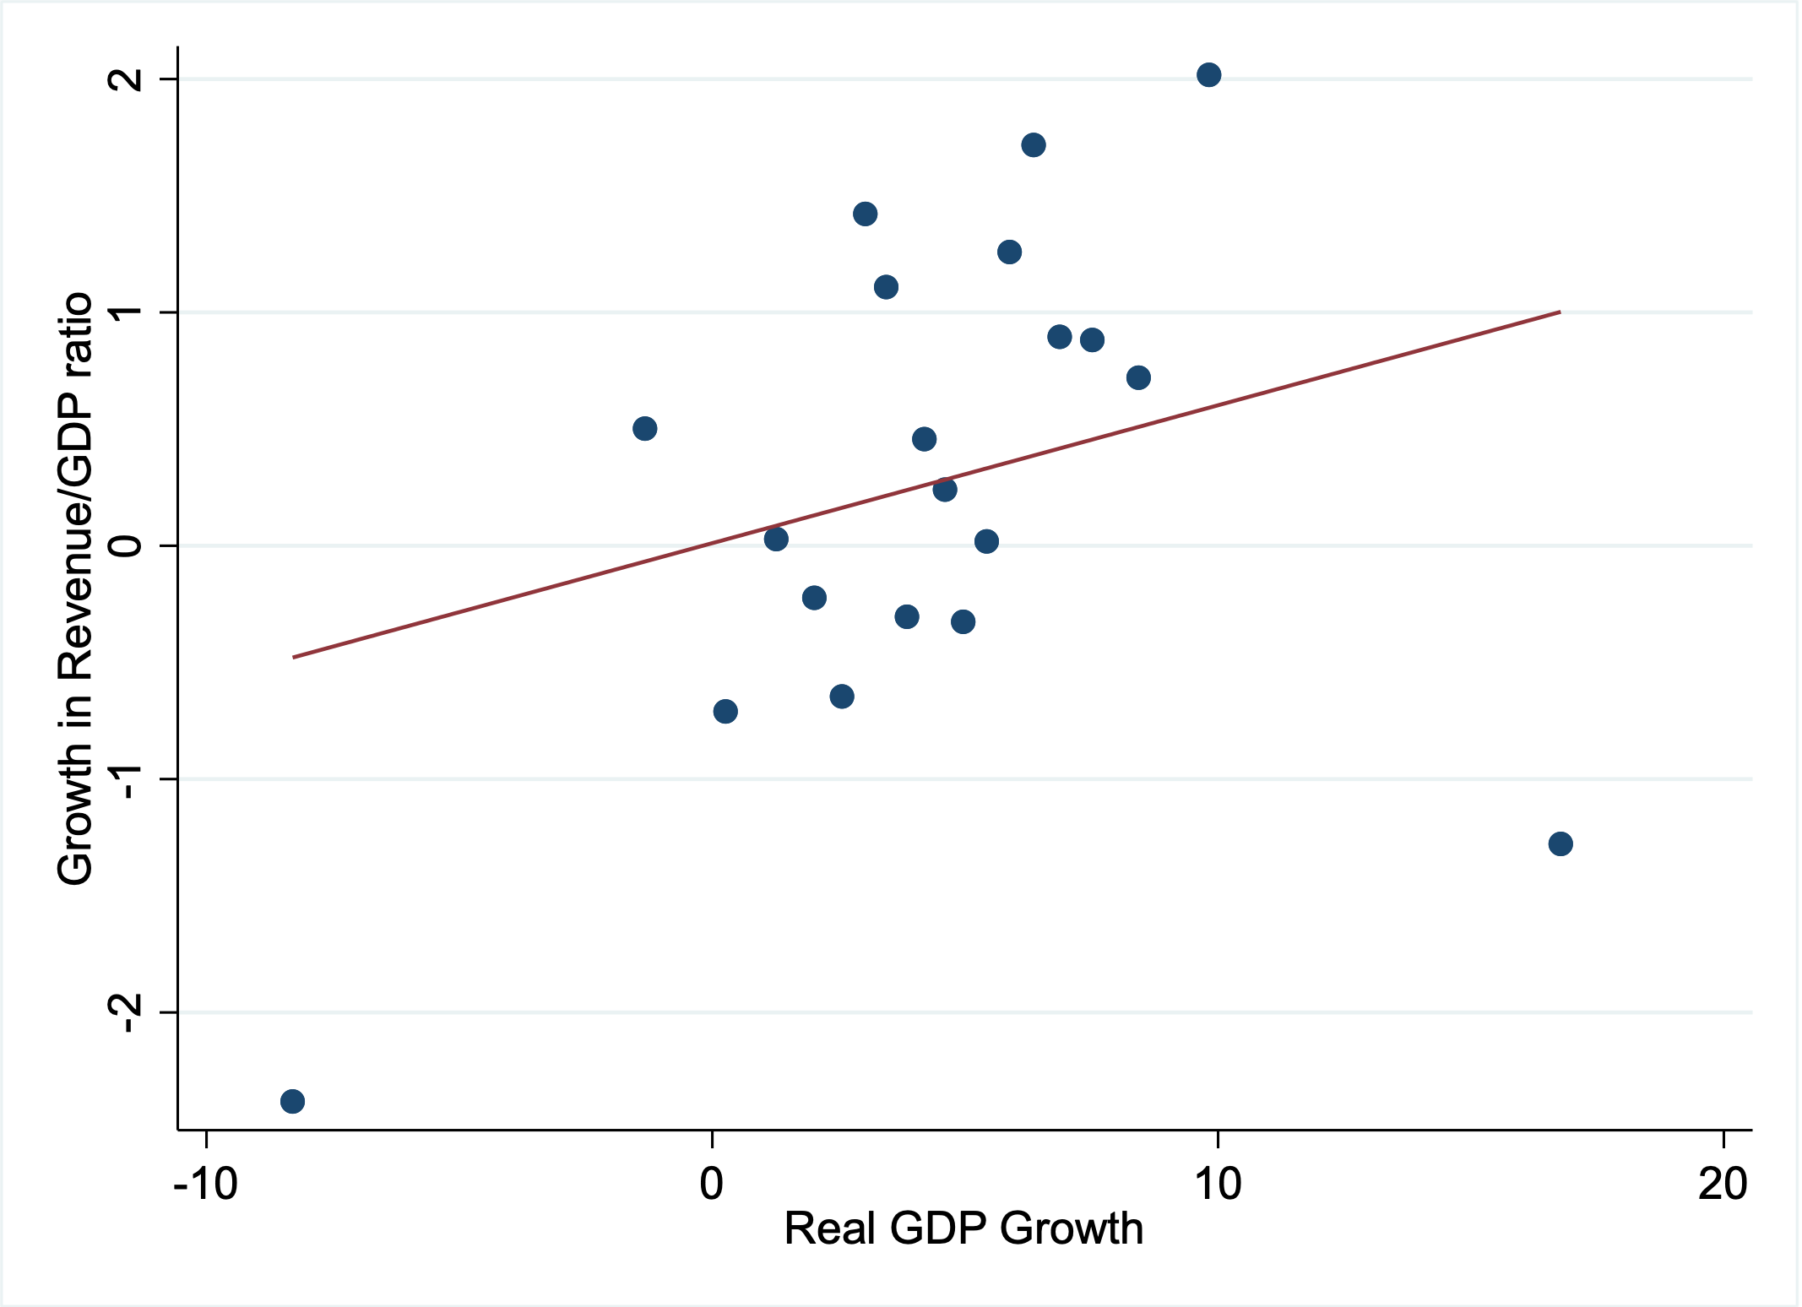
Policy priorities for post-COVID-19 recovery/2
Reforms in fiscal policies and revenue mobilizations . The mounting debt and limited fiscal space forces most governments in Africa to pursue a contractionary policy when stimulus is needed. To commit to expansionary policies, managing debt distress becomes important. Global development cooperation hence becomes vital for African governments to kick-start the economy. Evidence shows government revenue improves with accelerated growth, hence public finance positions.
Uncertainties influencing recovery due mainly to decline in global labor supply; structural transformations (acceleration towards labor-saving technologies) and disruptions in global supply chains).
Revenue buoyancy to growth in Africa

Slide 12
From AERC
Ahsante Sana
Thank You
MERCI BEAUCOUP
www.aercafrica.org

