Slide 1
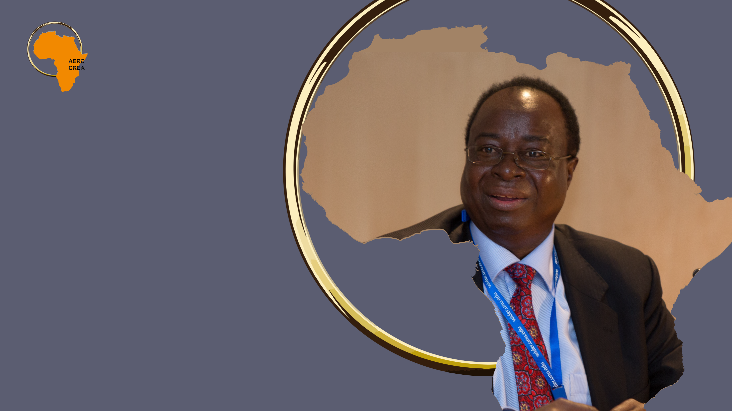
Celebrating
Prof. Benno Ndulu
An Intellectual and Policy Leader
Njuguna Ndung’u
African Economic Research Consortium (AERC)
6 September 2021

Slide 2
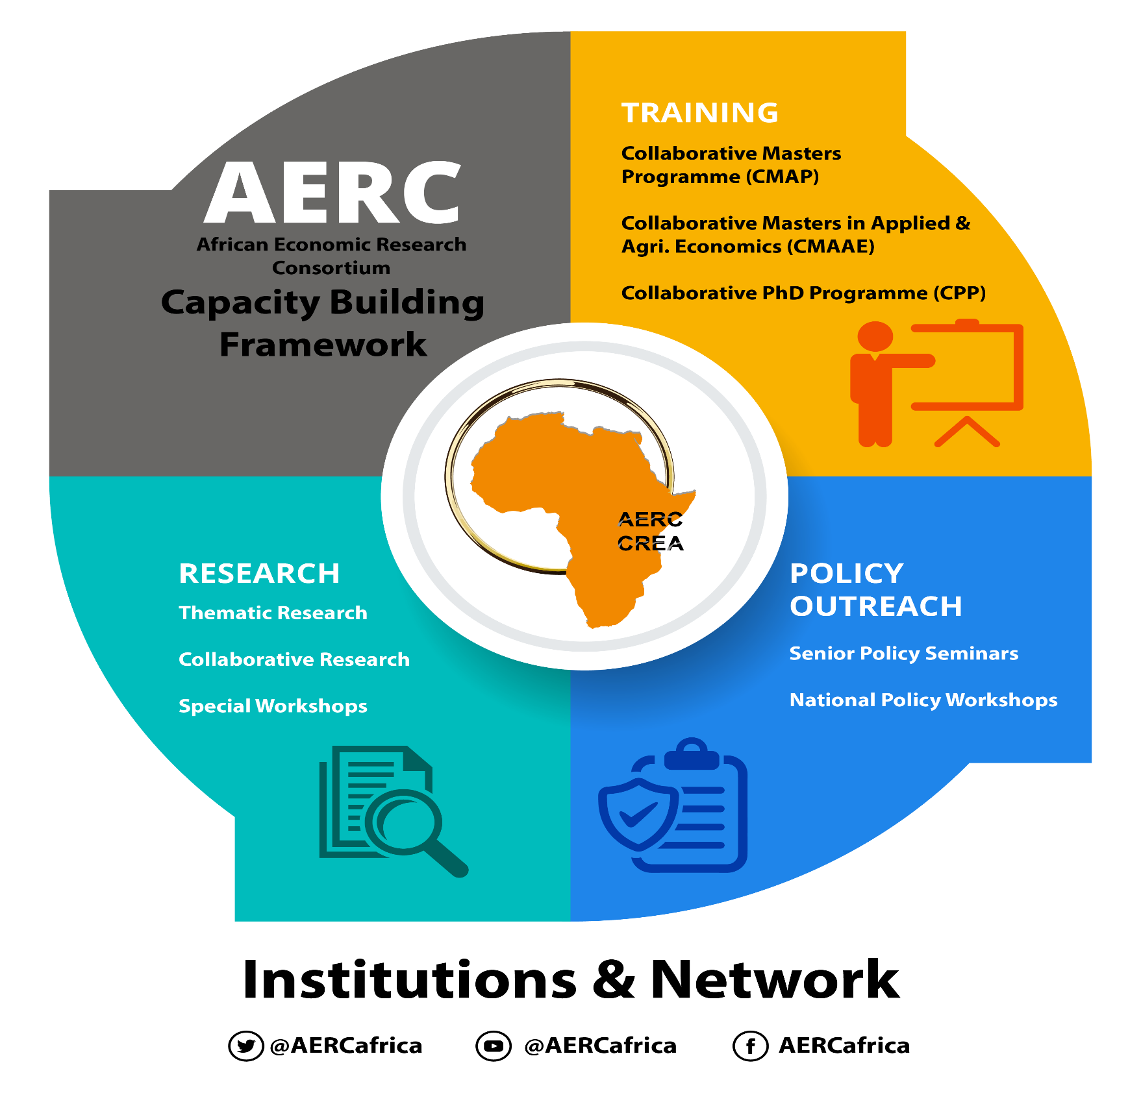

The AERC that Benno helped to Create:
Its Approach to Capacity Building and Knowledge Generation
“Governance affects long-term growth not only through policy distortions and transactions costs, but also via the capacity to handle external economic shocks as they occur.”
Prof. Benno Ndulu

Slide 3



Benno Ndulu: The Thought Leader
“One of our key comparative advantages is low labour costs and youth. The geese of manufacturing are flying westwards from East Asia. They will land in Africa and stay there.”
Prof. Benno Ndulu
  Leading light at the
  University of Dar es Salaam
  His publications span four decades
  Some Trails of Revolutionary Contributions:
      Agenda for Africa’s Economic Renewal – in the 1990s set the stage for richer and comprehensive reforms in African economies.
      Growth and Adjustment in sub-Saharan Africa - Economic Reforms in sub-Saharan Africa – in 1991.
      New Directions in Development Economics – 1996.
      Governance and Growth in Sub-Saharan Africa – 1999.
      Political Economy of Economic Growth in Africa - 2000: This has helped shift the policy narrative in Africa.

Slide 4



Benno Ndulu: Leading Innovations in Capacity Building
The first Director of Research at the AERC in 1988 – Building blocks of capacity building.
The first African Executive Director of the AERC in 1992.
“African countries need to pay the highest attention to startups.”
Prof. Benno Ndulu
Pioneering developments at the AERC: Collaborative Research in the 1990s and Graduate Training in 1993.
Supported the AERC Network and the Secretariat with innovative ideas for capacity building and funding AERC activities since then – from where he was sitting as Governor of the BoT, Coordinating the AERC African Central Bank Governors’ Forum, to the Programme Committee to the AERC Board.

Slide 5






Benno Ndulu: Leading Policy Advisory
The first AERC Senior Policy Seminar, 1995 – to reach out to policy makers and share research findings and a link to practical policy implementations.
Advisory role from governments to government agencies as well as multilateral institutions.
A long stint at the World Bank in Tanzania as Lead Economist and in The Vice President and Chief Economist Office in DC.
He was the Economic Advisor to the President RSA– But the history of his advisory role in RSA starts way back in the 1990s.
He was Economic Advisor to the Prime Minister of Ethiopia.
The most successful and celebrated Governor of the Central Bank in this region and beyond: 2008 - 2018.

Slide 6


Benno Ndulu: The Policy Leader
Designing monetary policy in the Bank of Tanzania.
Leading light in Monetary Policy reforms, regional integration in EAC, SADCC.
Leading light in Payment's system – The EAPS.
The pioneering push for digital financial systems – starting with the retail electronic payments system in East Africa.
Tanzania: The Path to Prosperity.
Commissioner – BMGF Digital Pathways for prosperity Commission on Technology and Inclusive Development – BSG, Oxford.
“Financial inclusion is important to the economy, it enables improving the welfare of the poor, contribute to financial stability, and to the growth of micro-business that ultimately stimulates the growth of other sectors in the economy.”
Prof. Benno Ndulu

Slide 7


A Friend and a Mentor
Benno was a friend, a role model and a mentor.
He was the only Governor in Africa to accept and replicate Kenya’s M-Pesa in the BoT.
He was at my defense when the IMF and the WB doubted
Kenya’s M-Pesa – the retail electronic payments platform and financial inclusion goal.
The two countries are now the most successful in digital financial services, financial inclusion and electronic payments infrastructure.
We then combined forces to lead the way in reformulating monetary policy framework in EAC countries with the support of the IGC.
He supported me as Chair in the formation of the Alliance for Financial Inclusion – AFI in 2009: A network of Financial Regulators that coordinated financial inclusion in Africa, Asia and Latin America – He later became Chair of AFI and pushed its expansion.
Africa’s growth record reflects a groping towards satisfactory modes of national governance under objectively difficult circumstances.
Prof. Benno Ndulu

Slide 8
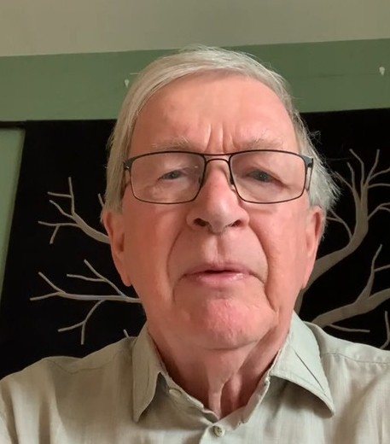
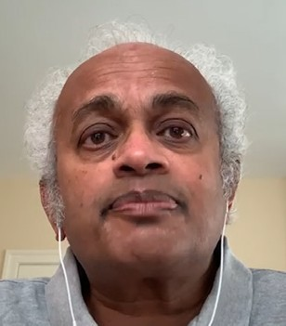
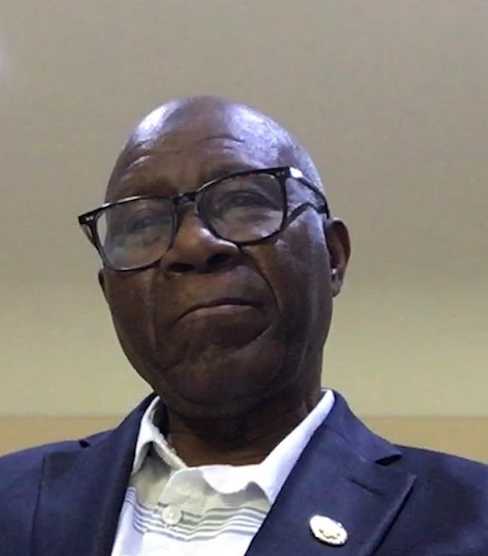
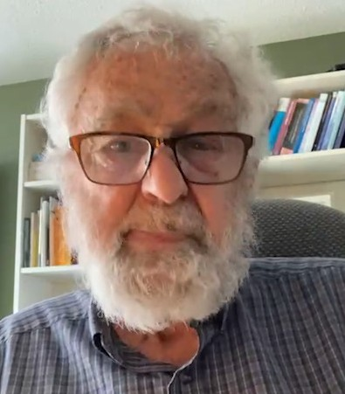
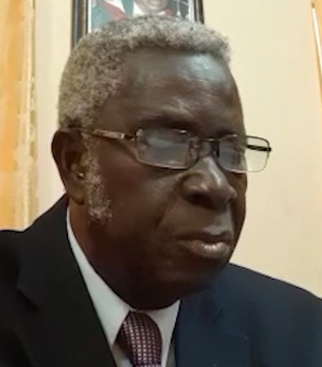
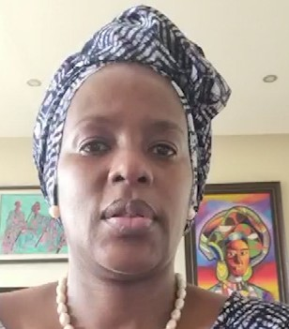
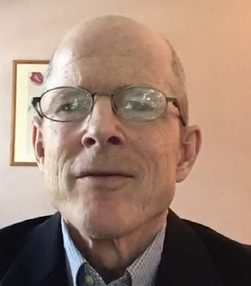
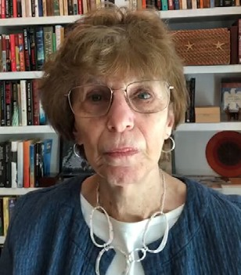
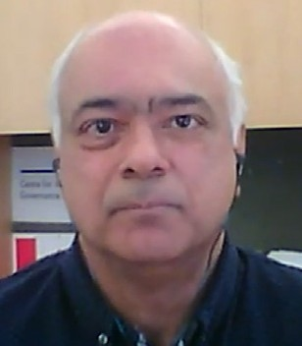
Prof. Benno Ndulu
Tributes
He was a truly great man. And I think he was the most important and best economist of his time in Africa. - Prof. Arne Bigsten
Prof. Benno mobilized a generation of economists, my generation, to dedicate ourselves to building research capacity among African economists; the African Economic Research Consortium, AERC is his biggest legacy. - Prof. Shanta Devarajan
Benno Ndulu wasn't just a great economist. He was a person who had wisdom, honesty, a great sense of humour, and was modest. Above all for me, he was a very good friend. - Prof. Gerry Helleiner
Prof. Benno Ndulu was an academic icon who stood very tall amidst his colleagues and remained very humble throughout his lifetime. - Prof. Ibi Ajayi
I want to praise Professor Benno for his great leadership style and his long-lasting impact at the AERC. Benno will be remembered for his outstanding contribution to capacity building on the continent.
- Dr. Kerfalla Yansane
We will always remember Professor Benno Ndulu, as this leader that reached out to Africans across all borders and brought us under the one roof of a Pan Africanist organization, the African Economic Research Consortium. - Dr. Barbara Barungi
Benno, was a prolific researcher on economic reform, governance and growth in Africa. His central theme was the vital importance of creating an enabling environment for growth and transformation. - Prof. Stephen O’Connell
Prof. Benno demonstrated a deep understanding of the relationship between research and the political process of policymaking; he greatly enhanced the synergy between AERC's research and training programs. - Dr. Joyce Moock
The AERC came into its own, under Benno's stewardship. He gave leading to something that so many of us talk about a lot, which is Southern voices, capacity building, developing countries, holding up their own when dealing with the very complex economic and other policy issues that they must grapple with.
- Dr. Rohinton Medhora

Slide 9

The Way Forward: Keeping the Memories of our Hero Alive
Memorial Lectures during the December 2021
Bi-Annual Conference.
“I do believe that the increase in political pluralism, in combination with greater unity among African aid donors, bodes well for a continuation of Africa’s growth recovery.”
Prof. Benno Ndulu
Publication of a Volume in Benno’s memory.
Establish a Scholarship in his name – The Benno Ndulu Scholarship Award – for the best male and female candidates every year in the AERC Training programmes.

Slide 10
Rest in Eternal Peace My Friend
From All of Us at the AERC
AHSANTE SANA
MERCI BEAUCOUP
THANK YOU
www.aercafrica.org

